Slide 1

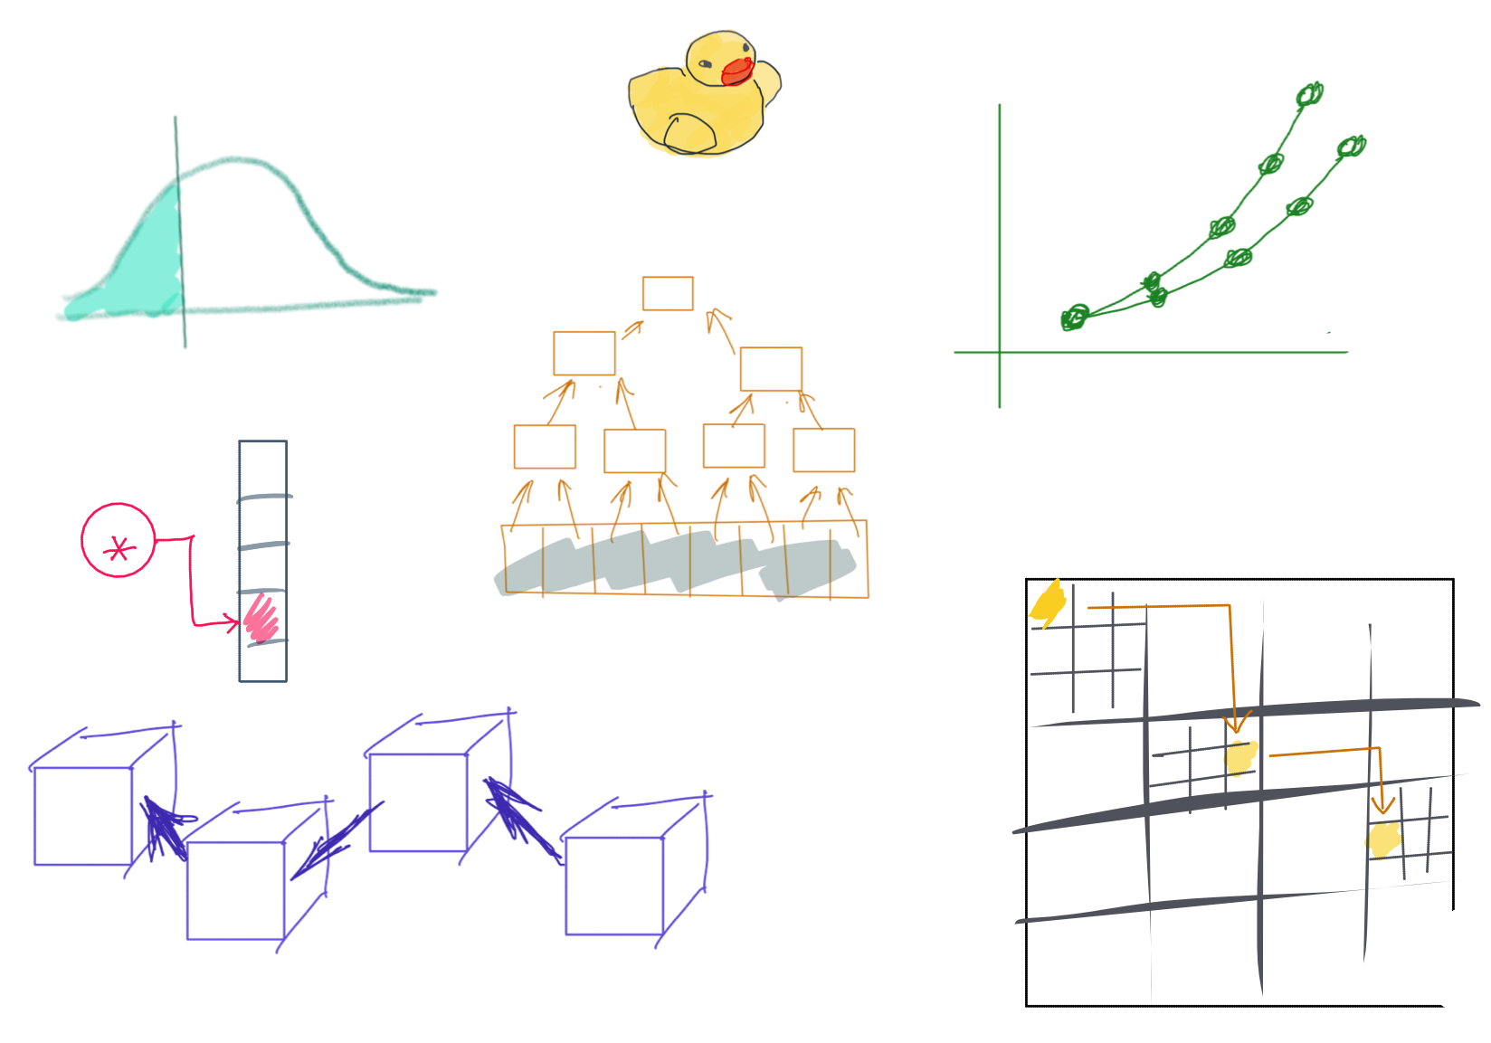

Slide 2

BootUp – C++

Slide 3

Lecturer
Peng Du
High performance computing
Matrix stuff, Matrix Factorization, etc
Cloud & Edge computing
Kubernetes, docker, etc.
Part-time Teaching
CSS 342
CSS 143

Slide 4

Agenda
Prelude: Tooling
Source code management
Build
Debug
ACT I: Basics
Variable
Pointer, reference
Array
Control flow (loop, if)
Function
ACT II: Memory Management
Heap vs stack memory
new & delete
Memory leak
Bad reference
ACT III: Object Oriented Programming
class
Object/instance
Inheritance
Metamorphism

Slide 5
Prelude: Tooling
Source code management
Build
Debug

Slide 6

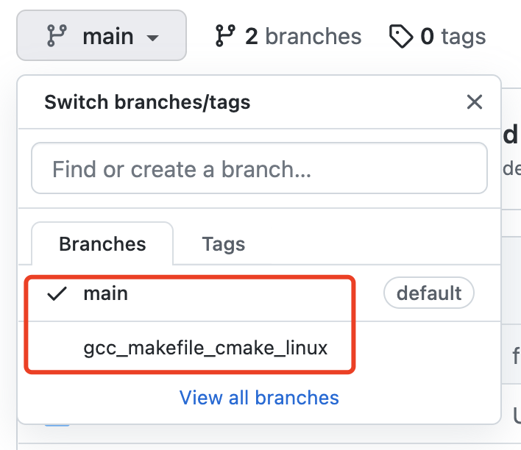
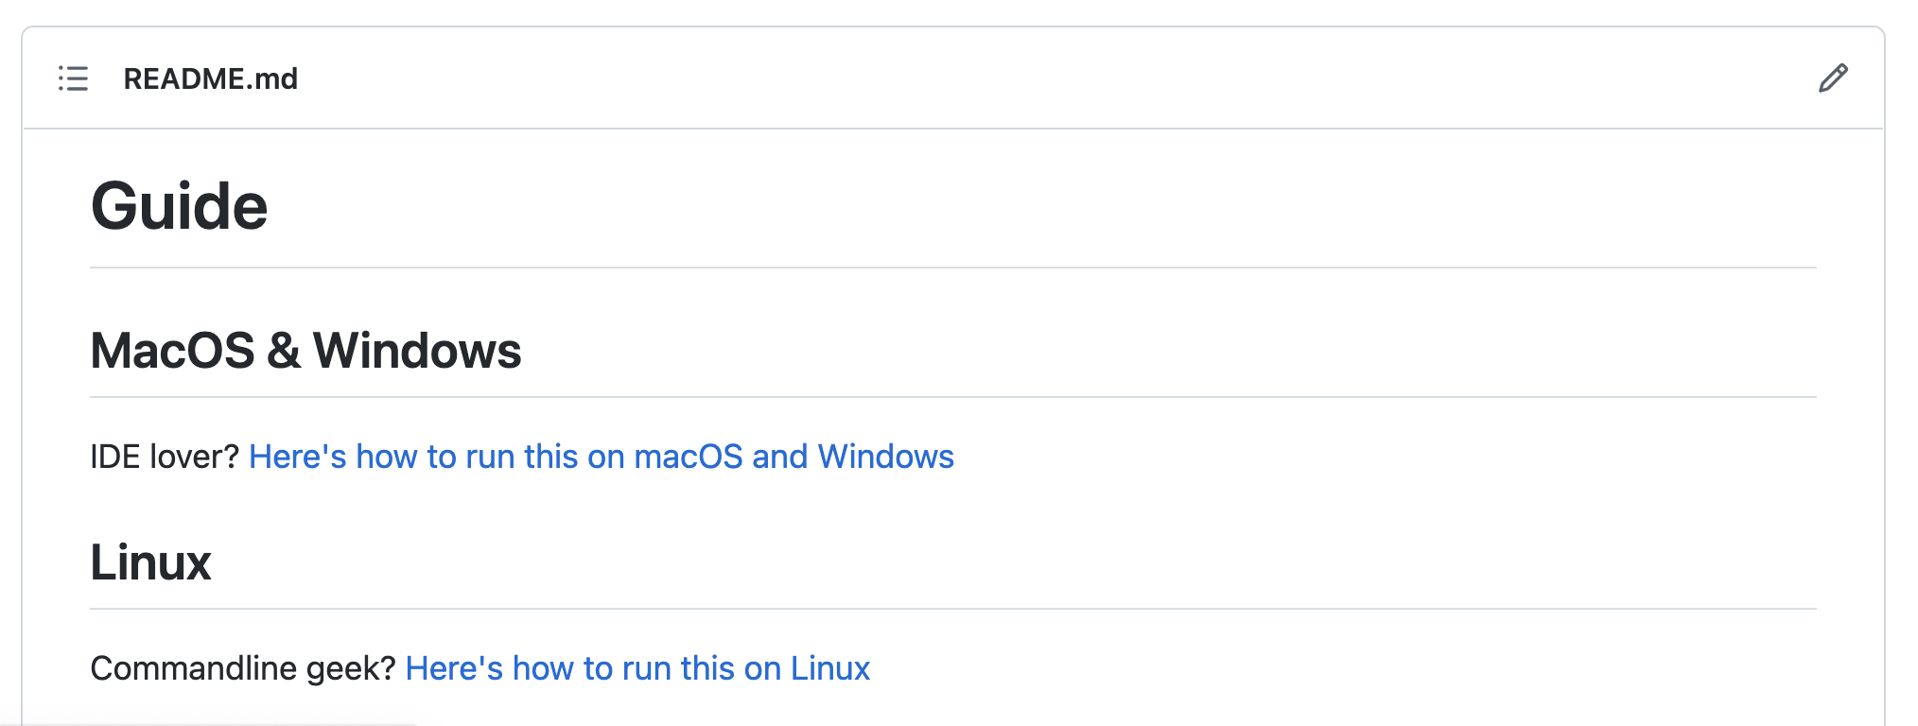
Code
https://github.com/a-teaching-goose/2022-bootup
https://github.com/a-teaching-goose/2022-bootup#readme
Usage instruction
Two branches, one for IDE and one for command line

Slide 7
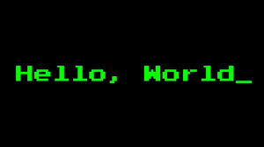
Code Demo

Slide 8
The Dev Environment

Slide 9
Tooling
OS:
Windows, Linux, Mac
IDE/Editor:
Visual studio, VS Code, Clion, Xcode, Atom, etc.
VIM, Emacs
Makefile, CMake
Online Editor
Testing:
A review by Clion
Googletest
Source Control
Git, www.github.com

Slide 10
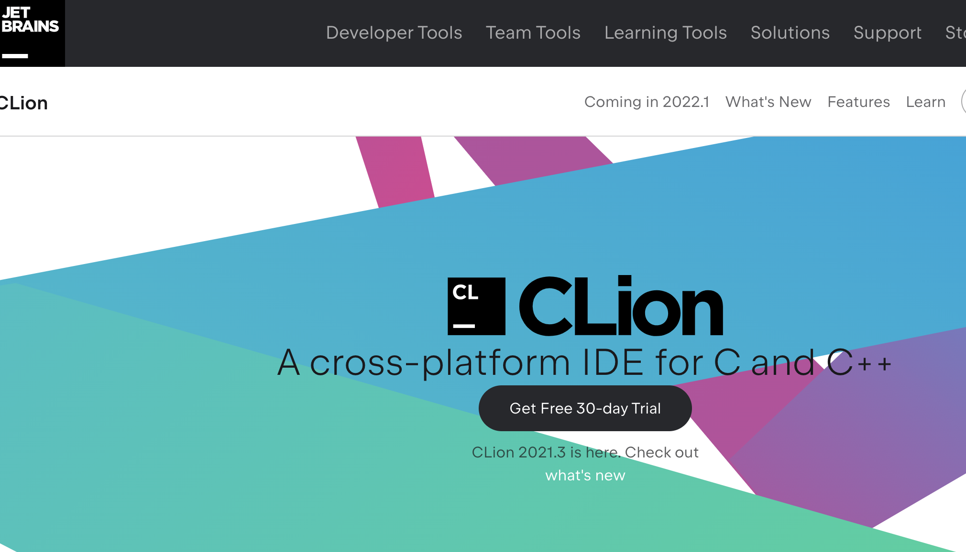

Editor: IDE
It’s Free!
https://www.jetbrains.com/clion/
https://www.jetbrains.com/community/education/#students

Slide 11

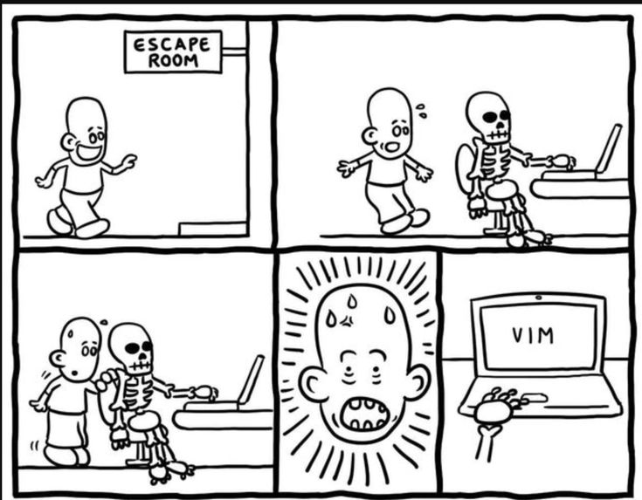
Editor: Vim (Linux)
Available on (pretty much) all OS
Website in 80s, but probably the best editor you’ll have in your life

Slide 12

Source Control
“My laptop crashed last night, and my homework is gone”
How do you safely store your code and track changes?

Slide 13
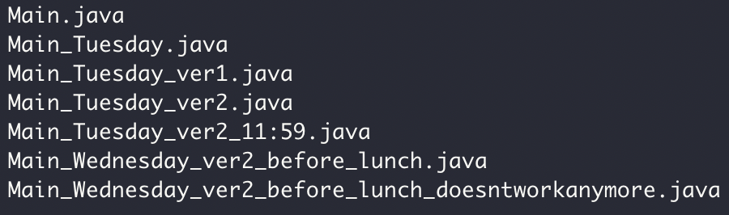

Source Control

Slide 14

Why Git and GitHub
Widely used in industry and open source projects
Easy to track progress (commits)
Easy to track features (branch)
Easy to collaborate with others (GitHub)
Example: https://github.com/futurewei-cloud/chogori-platform

Slide 15


Source Control
Code version 1
Code version 2
Code version 3
“commits”
Code version 1
Code version 2
Code version 3
Code
……
Your computer
Monday
Tuesday
Wednesday
Thursday

Slide 16



Git/GitHub Terms
Repository, or “Repo”
Collection files from a project
Commit
A snapshot of the repo at the certain time
Branch
A line of development, consisting of a series of commits

Slide 17
Source Control: Branch
Commit 1
Commit 2
Commit 3
Commit 6
Merge, Commit 7
The Main branch
another branch
Commit 4
Commit 5

Slide 18



Push
Pull

Slide 19
Pull
Push

Slide 20
Homework repo
Exact Mirror
Homework repo

Slide 21
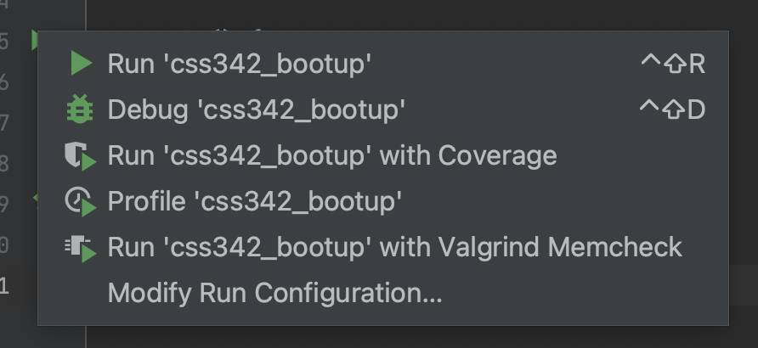
Code -> Binary
What happens when you click

Slide 22
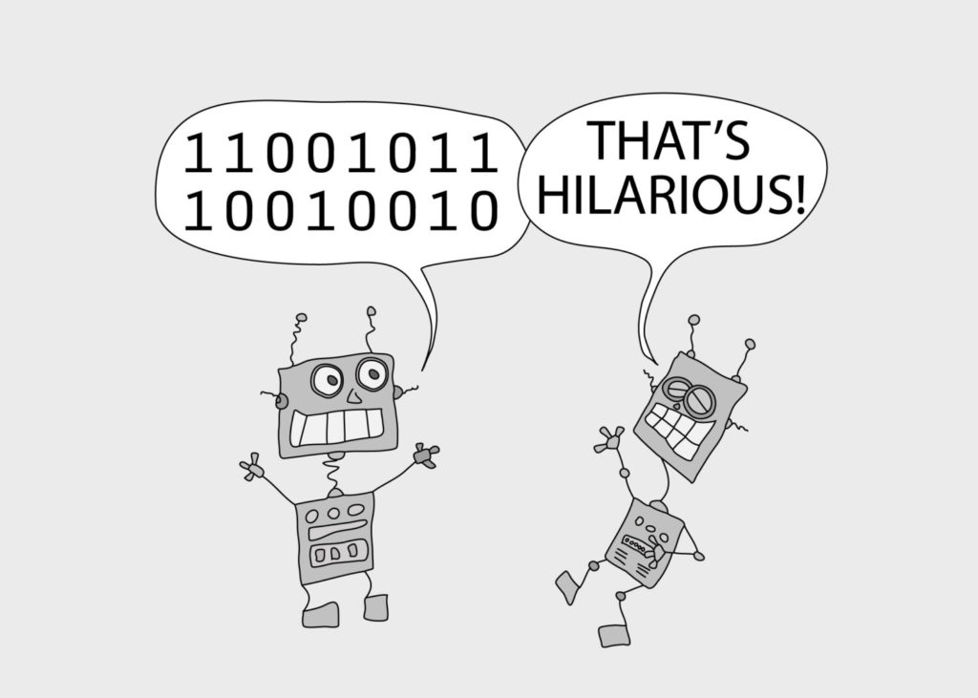
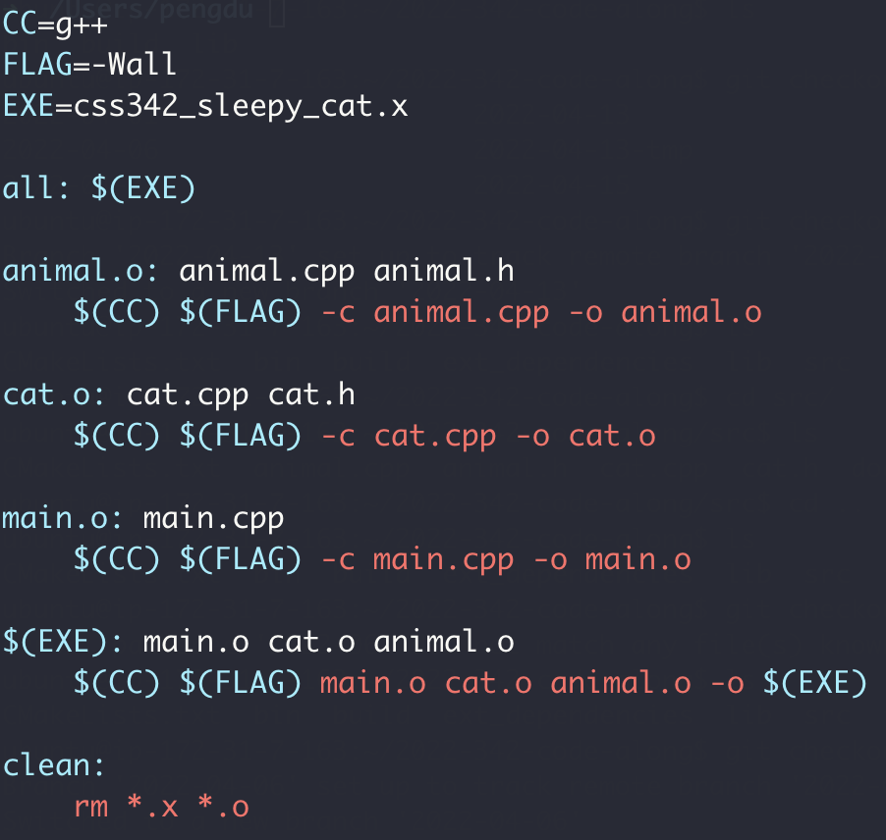
Makefile

Slide 23
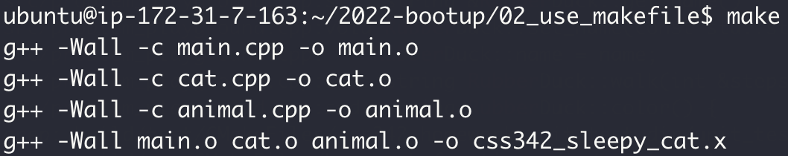
Makefile

Slide 24
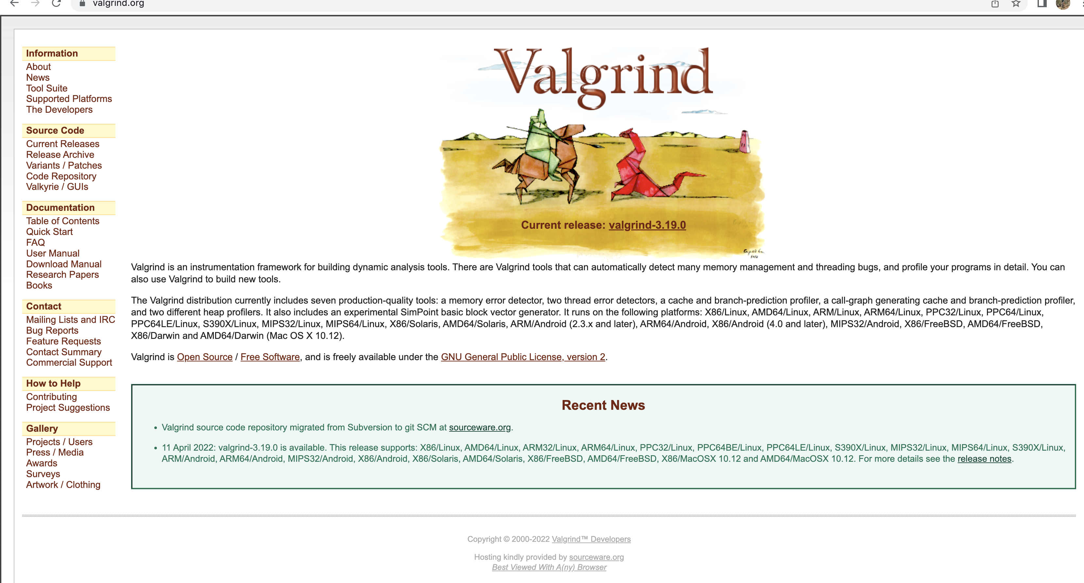
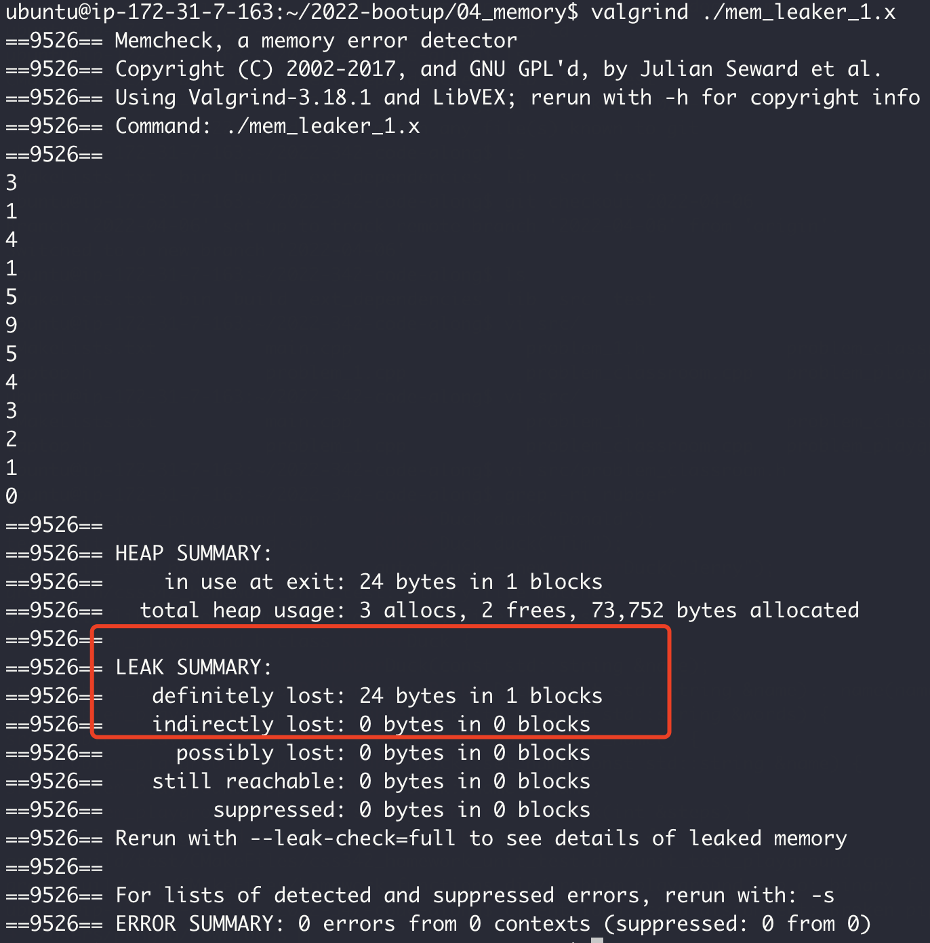
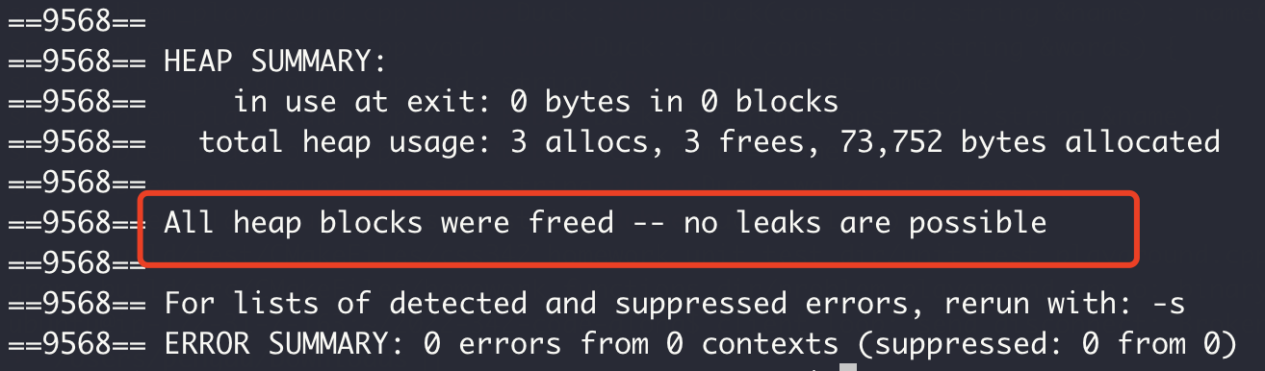
Memory Checker

Slide 25
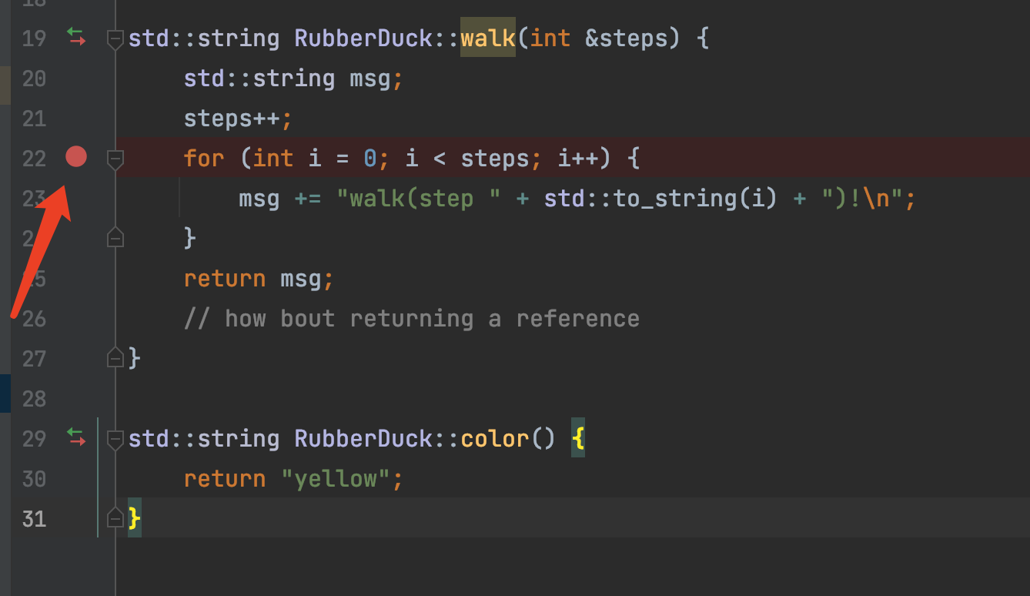
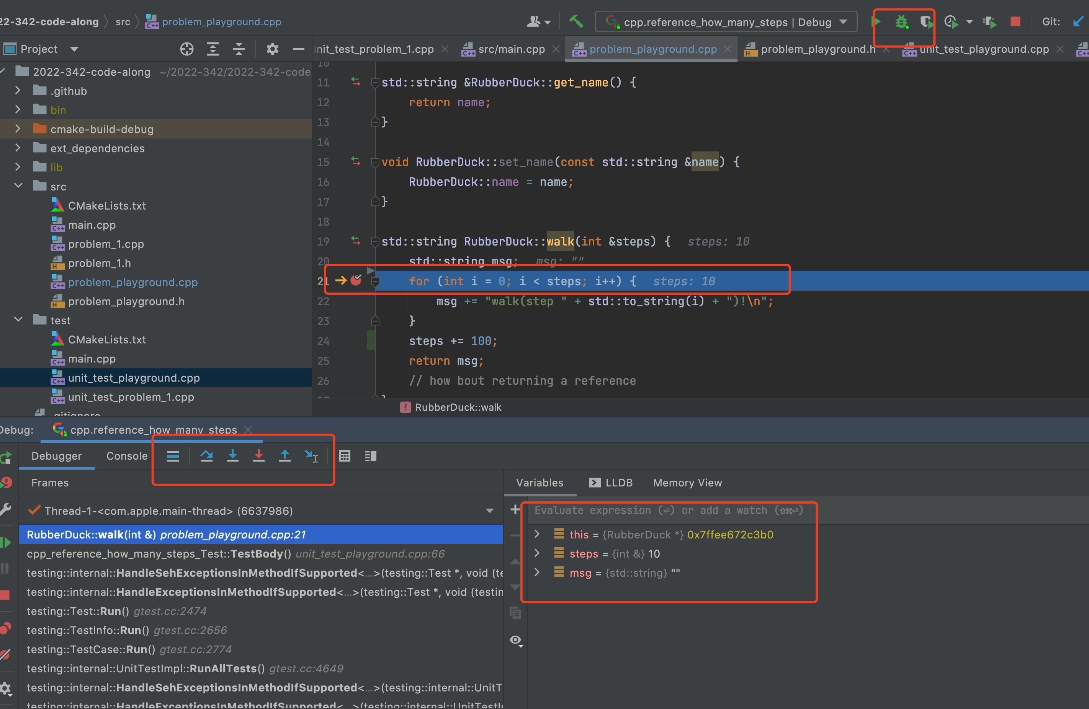
Debugging
Breakpoint
Step in
Step over
Read Variable

Slide 26
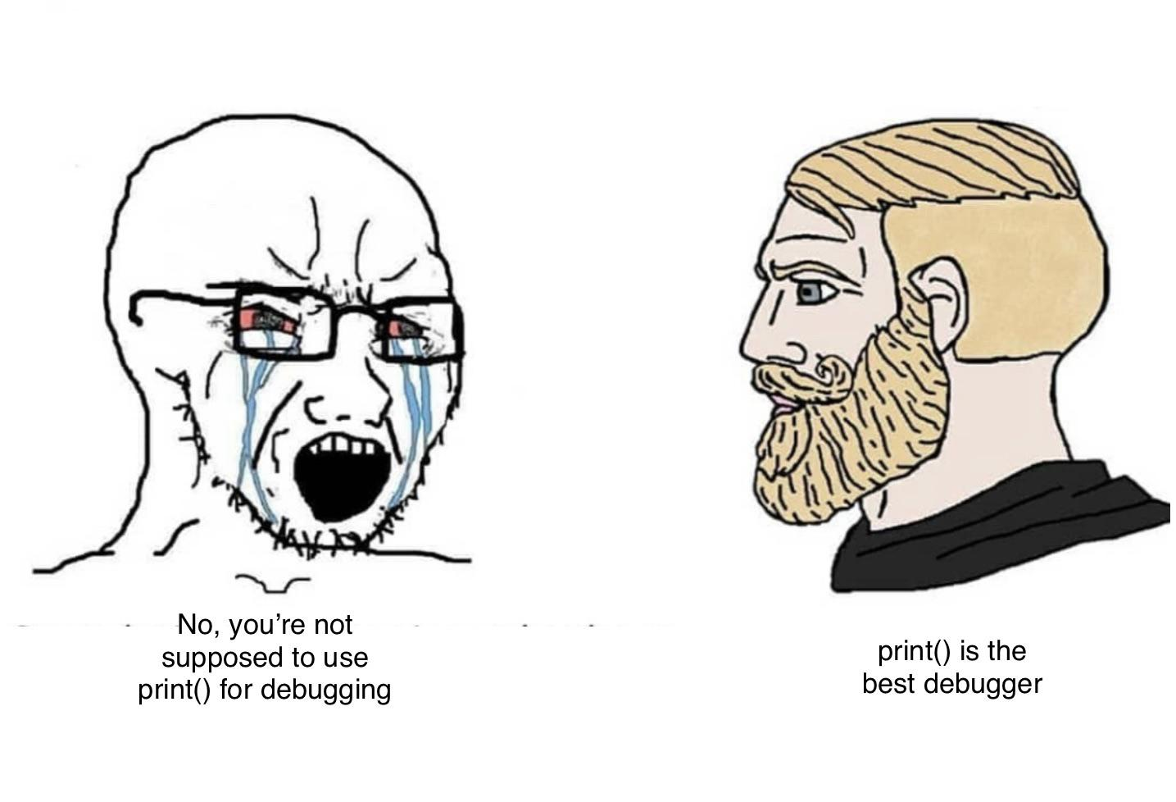
Print ain’t for debugging

Slide 27
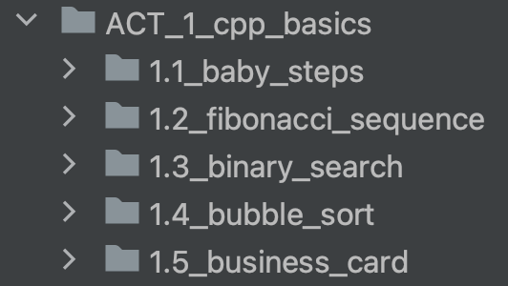
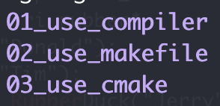
ACT I: Basics
Variable
Pointer, reference
Array
Control flow (loop, if)
Function
Branch: main
Branch: gcc_makefile_cmake_linux

Slide 28

Memory
Data
Memory (Storage)
Computer Memory
0
8
Data
Memory Address
16
32
… …

Slide 29
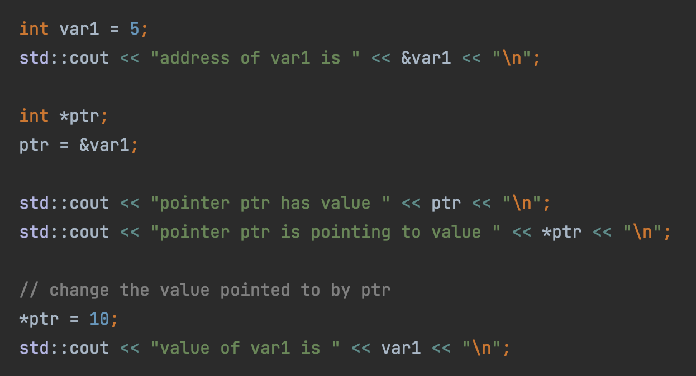

Pointer
Hexadecimal Address
0x0
1 byte (8 bits)
0x8
0x10
0x18
Var1 (5)
sizeof(int)
4 bytes
… …
ptr (0x18)
sizeof(int*)
8 bytes

Slide 30
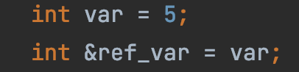
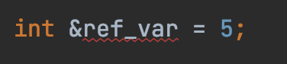
Reference
Hexadecimal Address
0x0
1 byte (8 bits)
0x8
0x10
0x18
Reference: a label (new name) to an existing variable
… …
Var1 (5)
ref_var
What’s wrong with this?

Slide 31

Binary Search
Target: 14
1
3
5
7
9
10
12
12
14
14
18

Slide 32
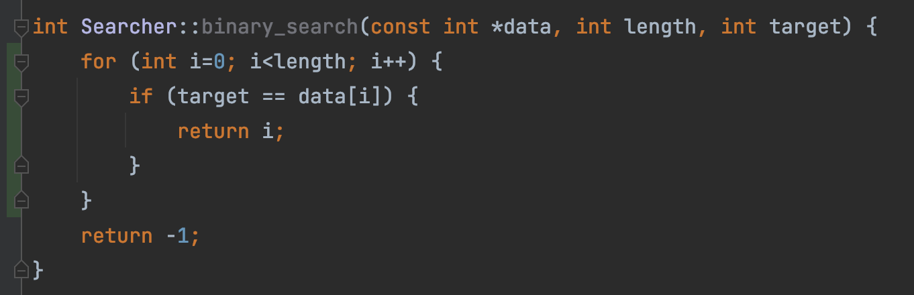
This is linear search, not binary search
“But test passed!”
Test passed
➔ ?
Code is correct
Test failed
➔ ?
Code is wrong

Slide 33
Bubble Sort
9
1
8
7
3
1
9
8
7
3
Round 1
1
8
9
7
3
1
8
7
9
3
1
8
7
3
9

Slide 34
1
8
7
3
9
1
8
7
3
9
Round 2
1
7
8
3
9
1
7
3
8
9

Slide 35
1
7
3
8
9
Round 3
1
7
3
8
9
1
3
7
8
9

Slide 36
1
3
7
8
9
Round 4
1
3
7
8
9

Slide 37
1
3
7
8
9
Round 5
1
3
7
8
9

Slide 38
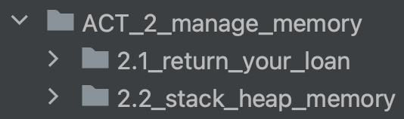
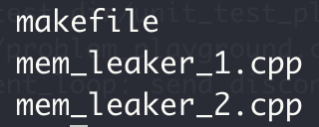
ACT II: Memory Management
Heap vs stack memory
new & delete
Memory leak
Bad reference
Branch: main
Branch: gcc_makefile_cmake_linux

Slide 39
Stack vs Heap
0x0
1 byte (8 bits)
0x8
Not automatically free/returned to OS
0x10
Heap
0x18
new operator
malloc
… …
Automatically free/returned to OS
Stack
function local variables

Slide 40
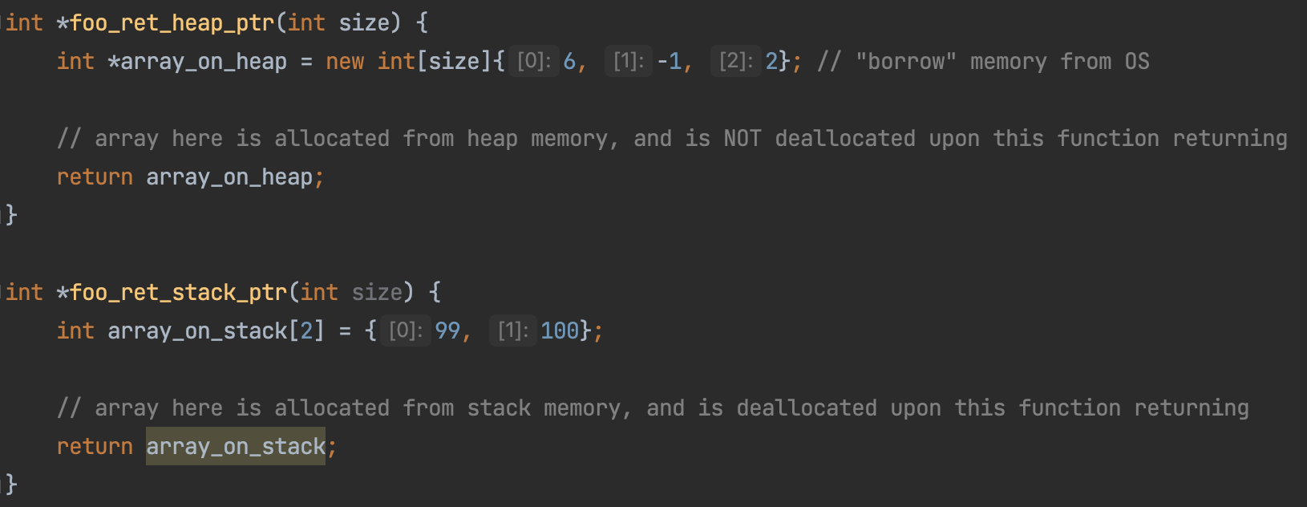
Stack vs Heap
0x0
1 byte (8 bits)
0x8
0x10
Heap
0x18
… …
Stack

Slide 41
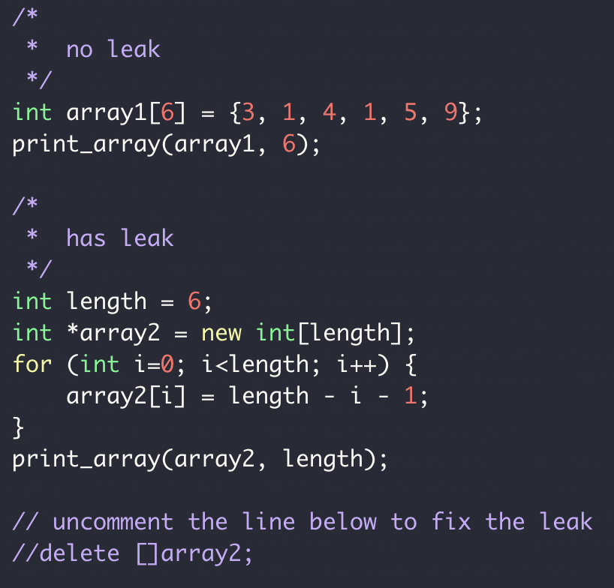
Memory Leak
0x0
1 byte (8 bits)
0x8
0x10
Heap
0x18
… …
Stack

Slide 42
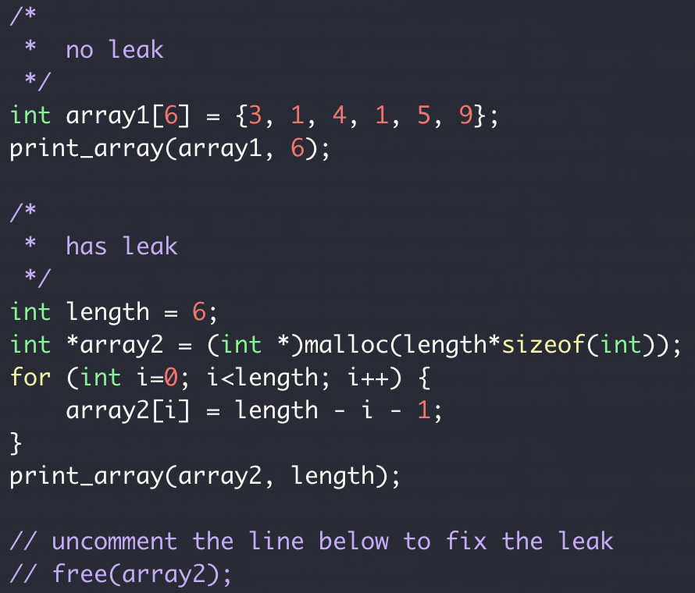
Memory Leak
0x0
1 byte (8 bits)
0x8
0x10
Heap
0x18
… …
Stack

Slide 43
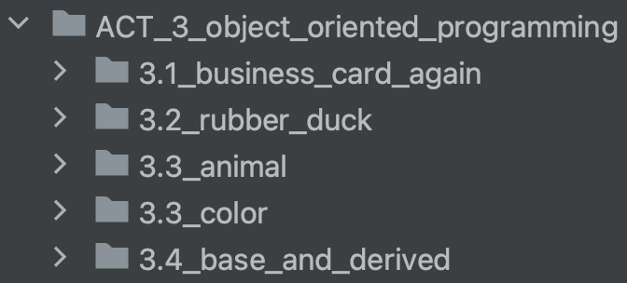
ACT III: Object Oriented Programming
class
Object/instance
Inheritance
Metamorphism
Branch: main

Slide 44
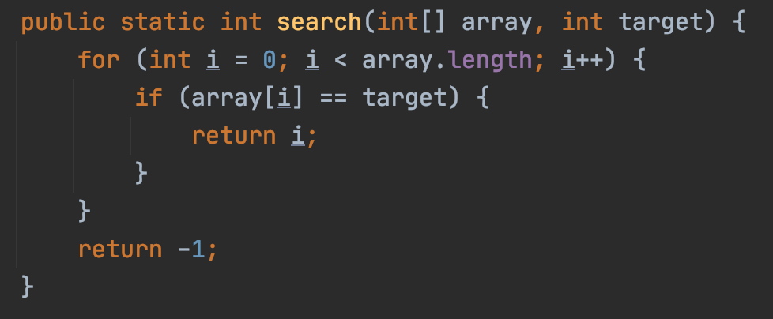
Object Orient Programming
Functional
OOP

Slide 45
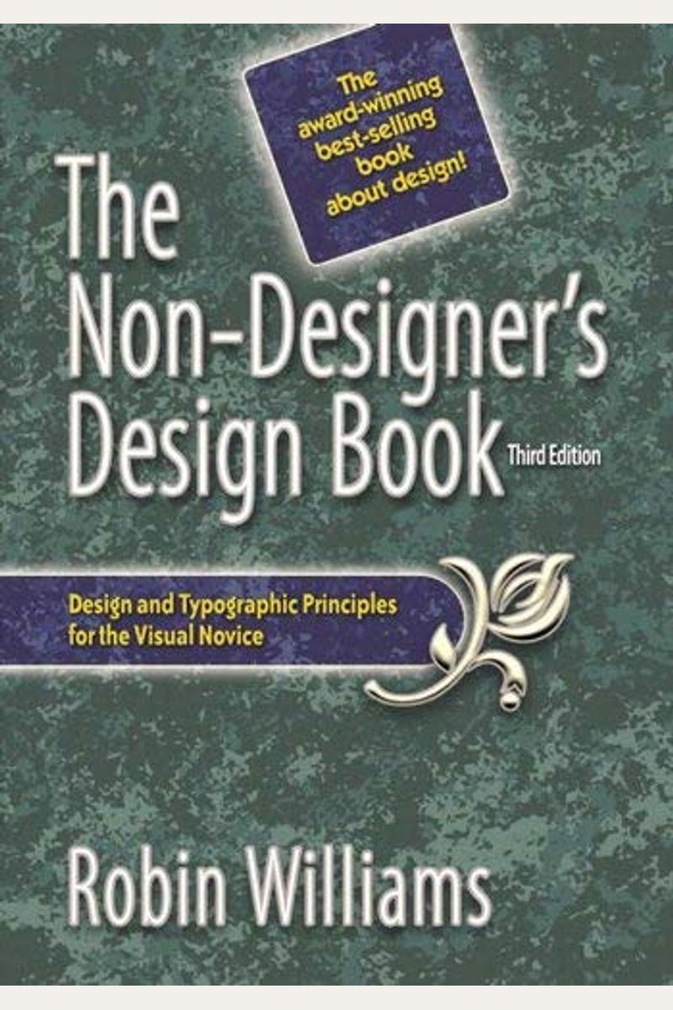
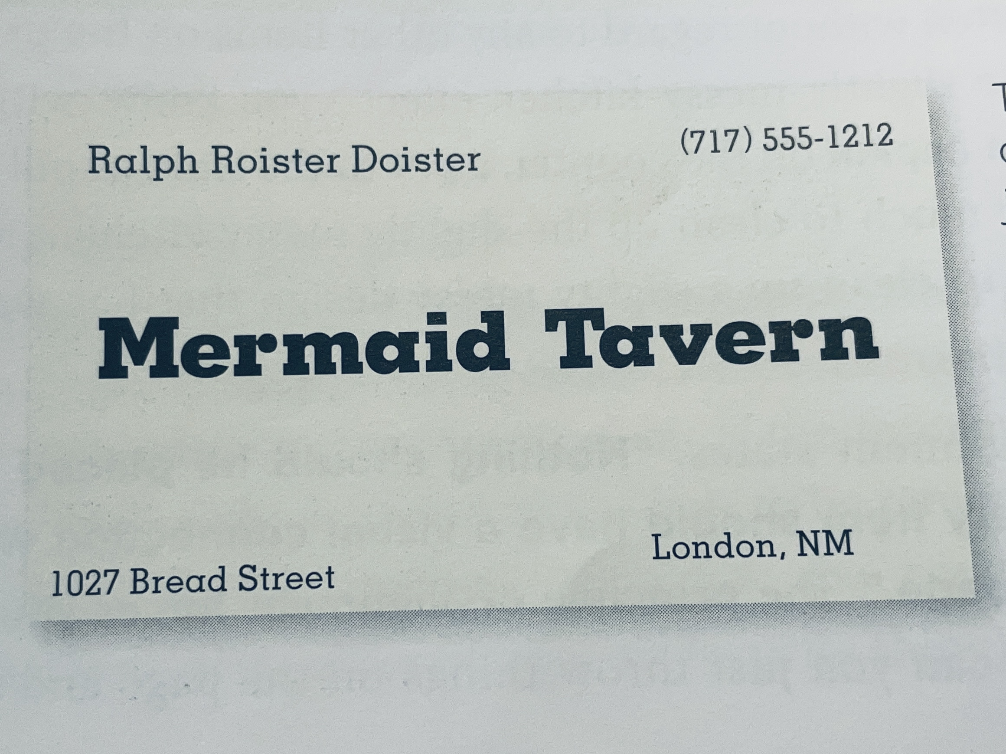
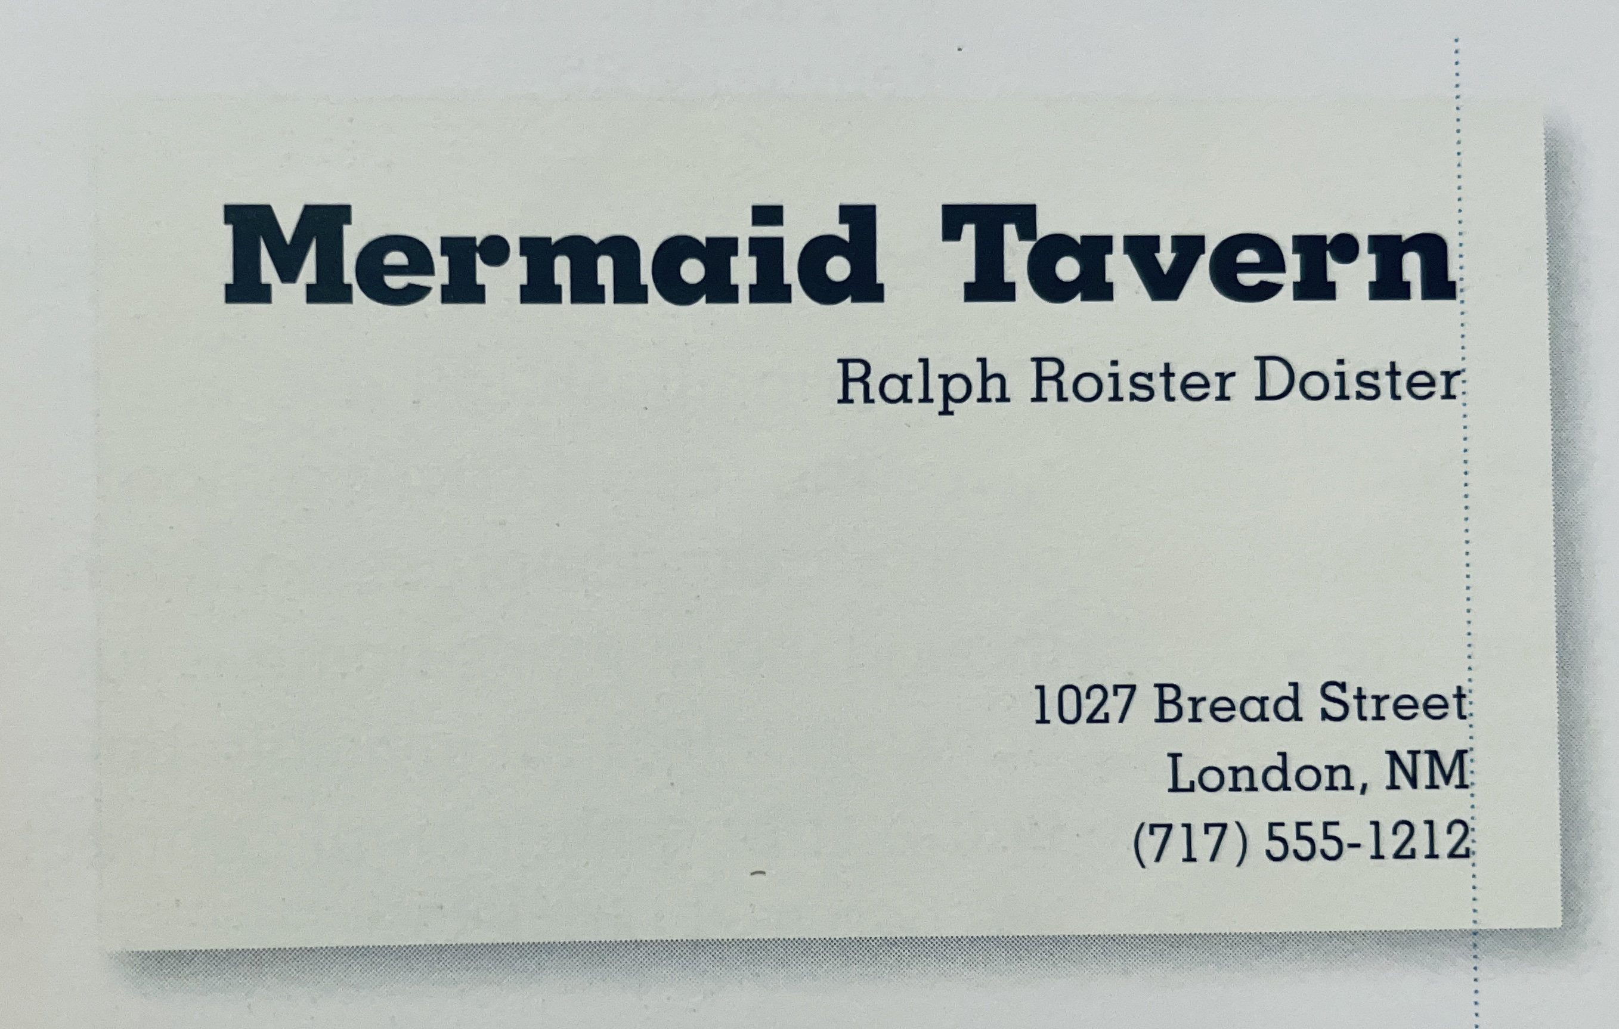
Why Object Oriented?
What’s the design issue with this business card?
Group related information together

Slide 46
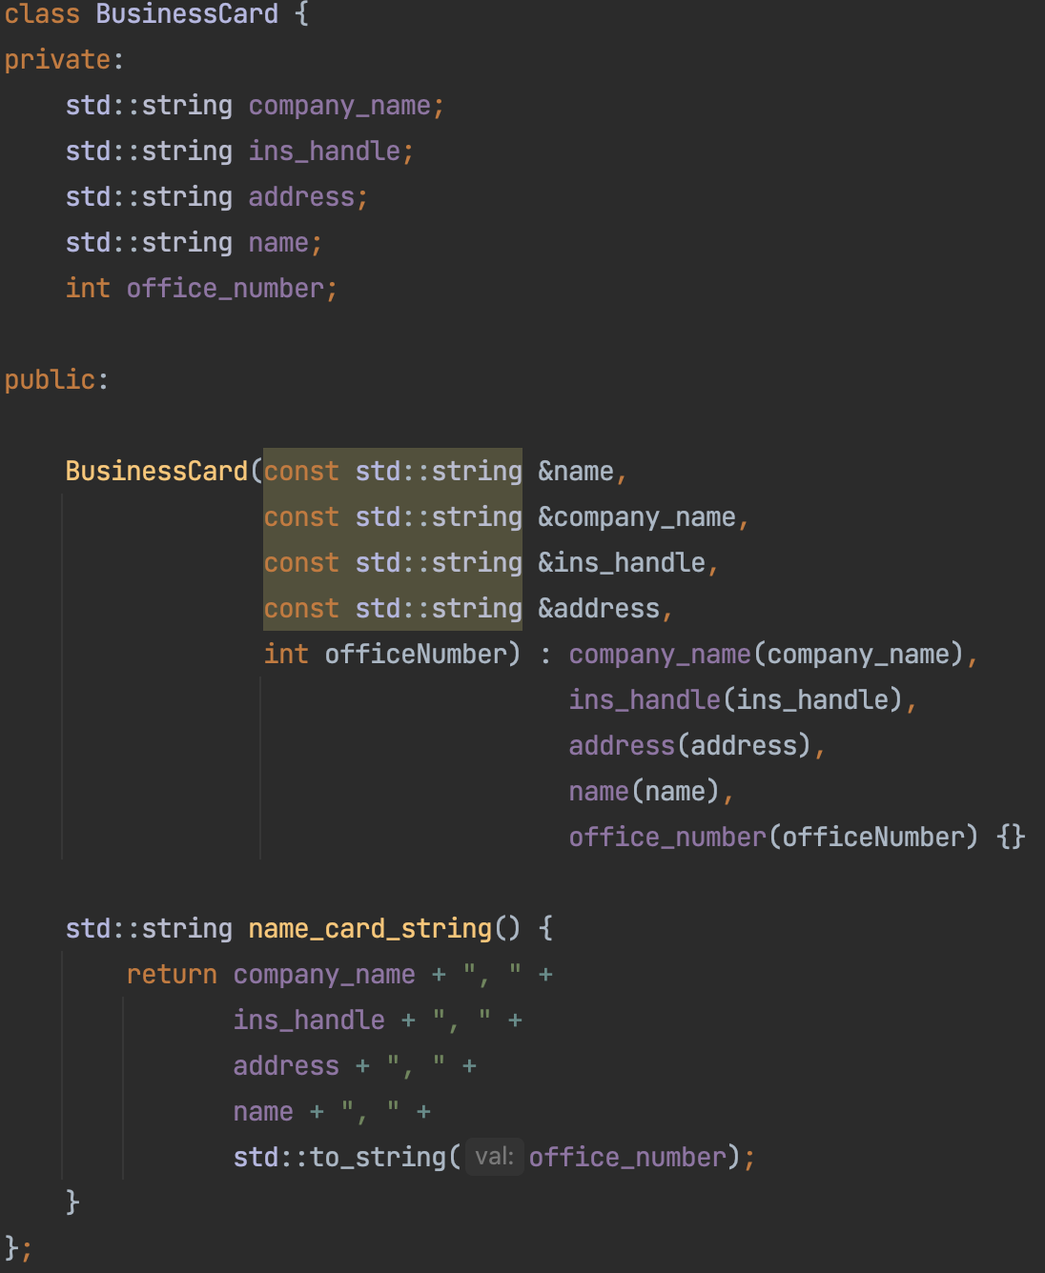
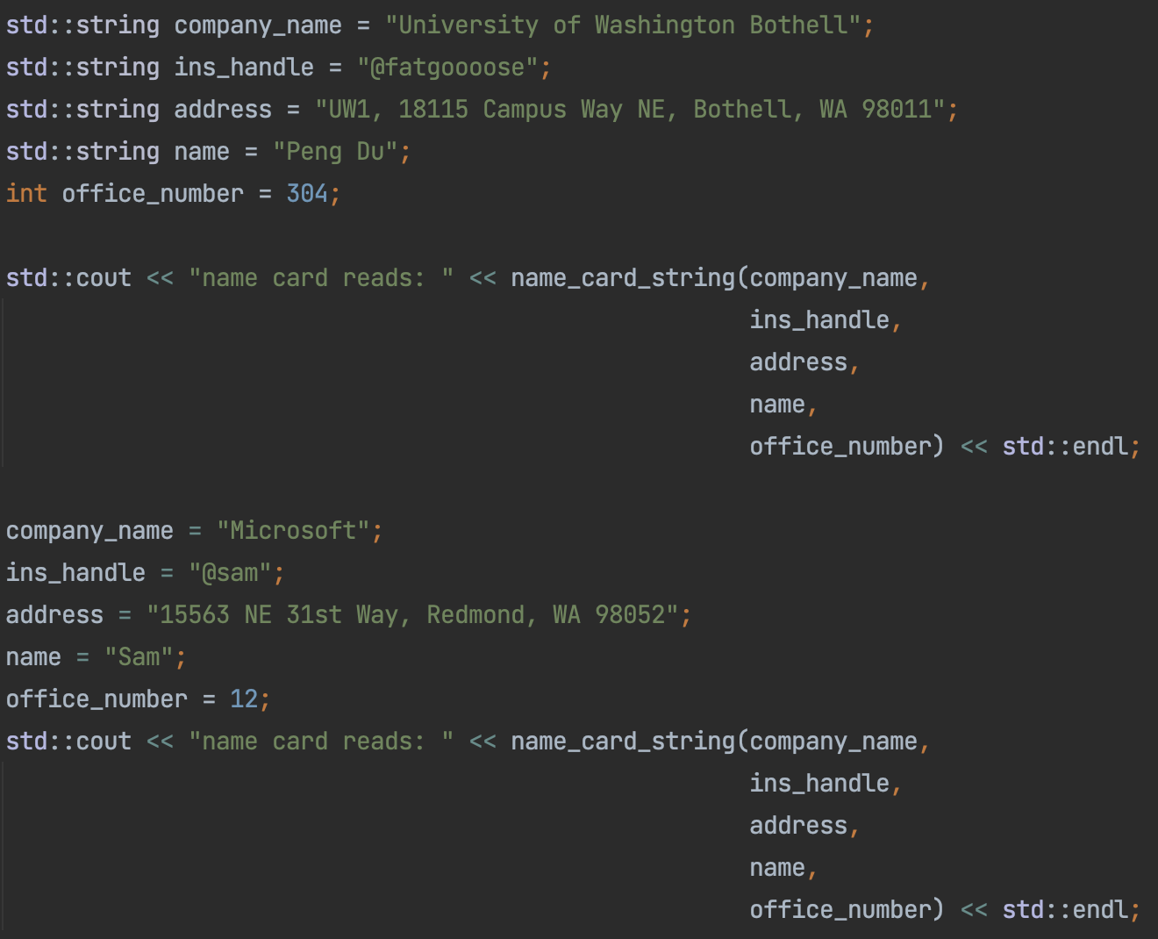
Why Object Oriented?
OOP: Group related information together

Slide 47
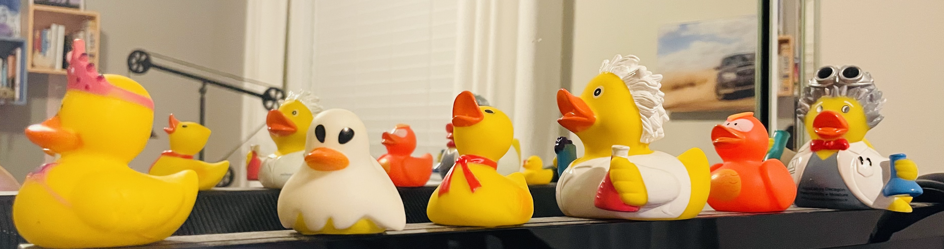

Class vs Object vs Instance
Class：
A “kind” of thing
Object：
Concrete Object
“Rubber Duck”

Slide 48
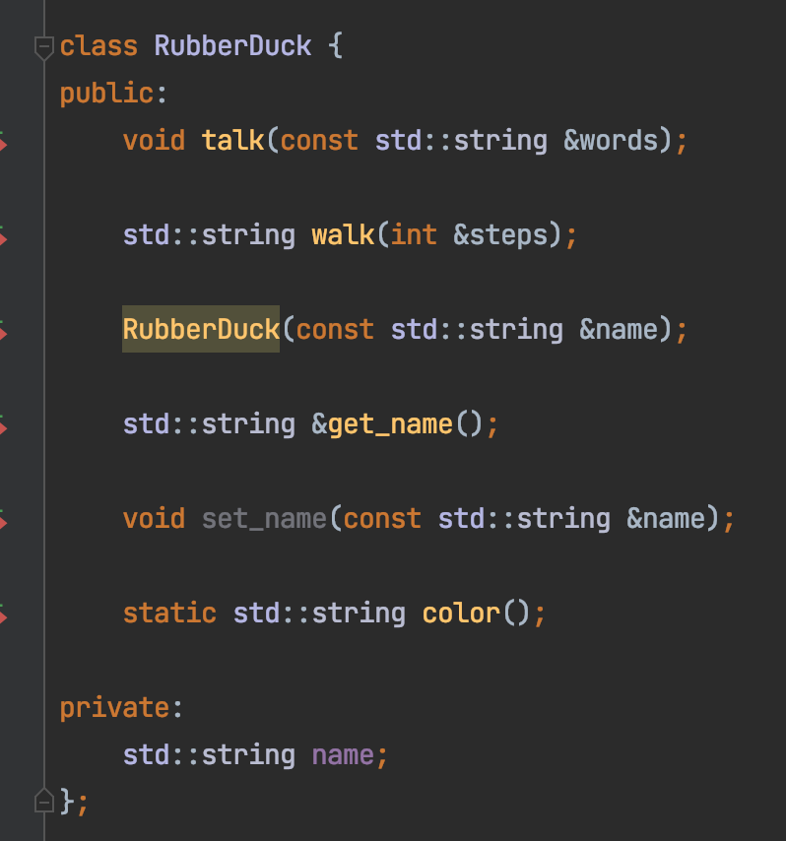
Class
Member Variables:
Name
Member Methods:
walk
talk

Slide 49
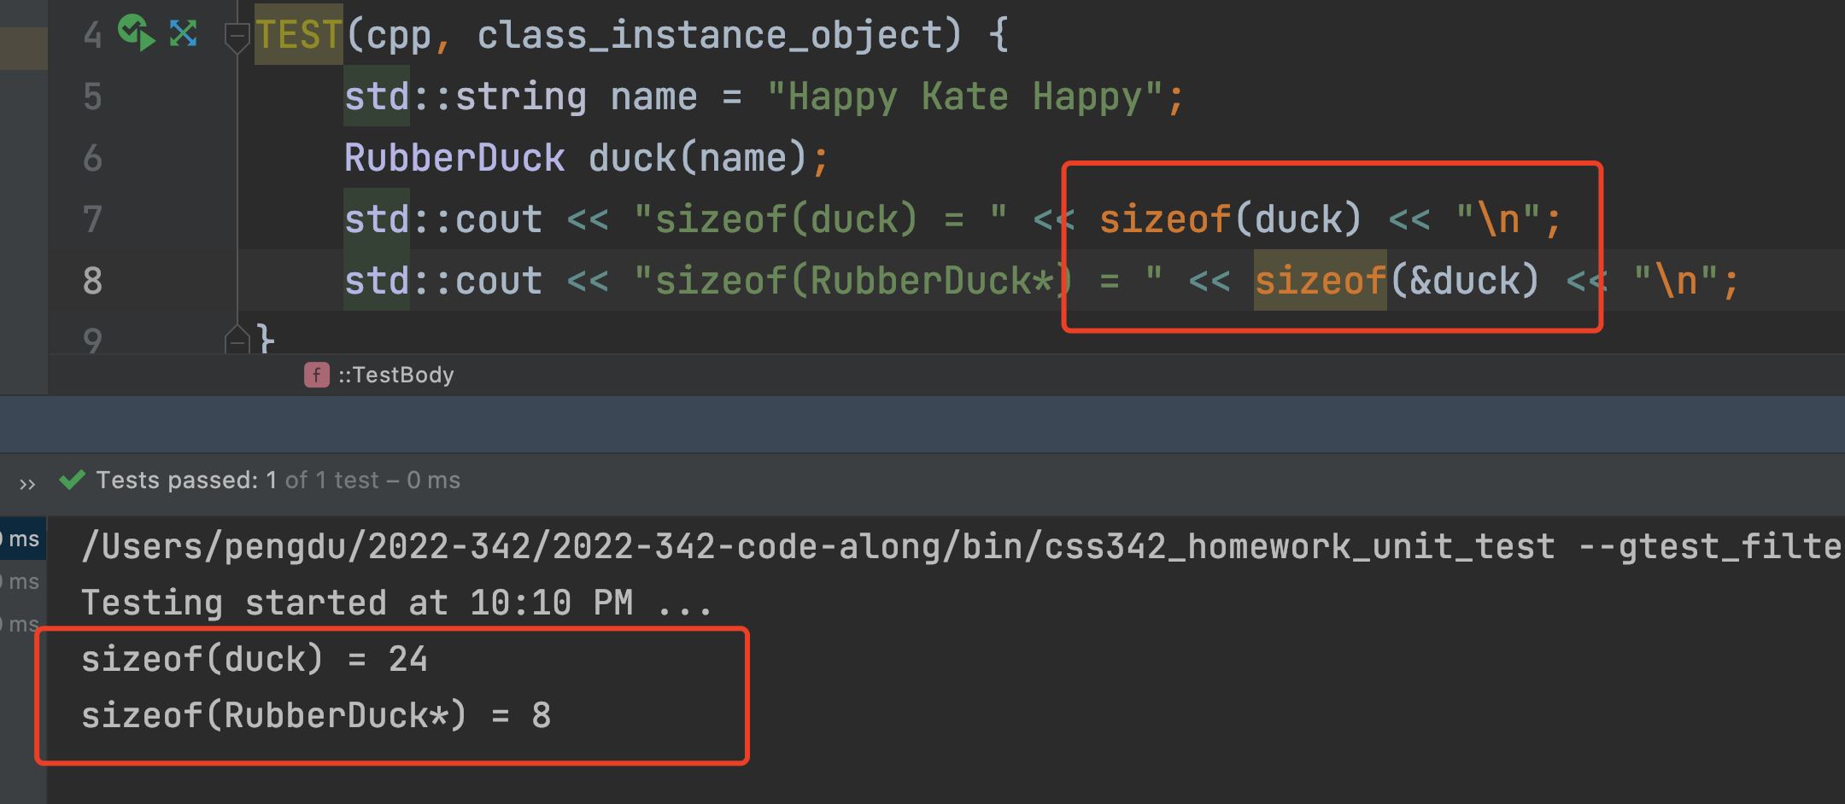
Class Instance
Hexadecimal Address
0x0
1 byte (8 bits)
0x8
0x10
0x18
… …
duck
sizeof(int*)
24 bytes

Slide 50

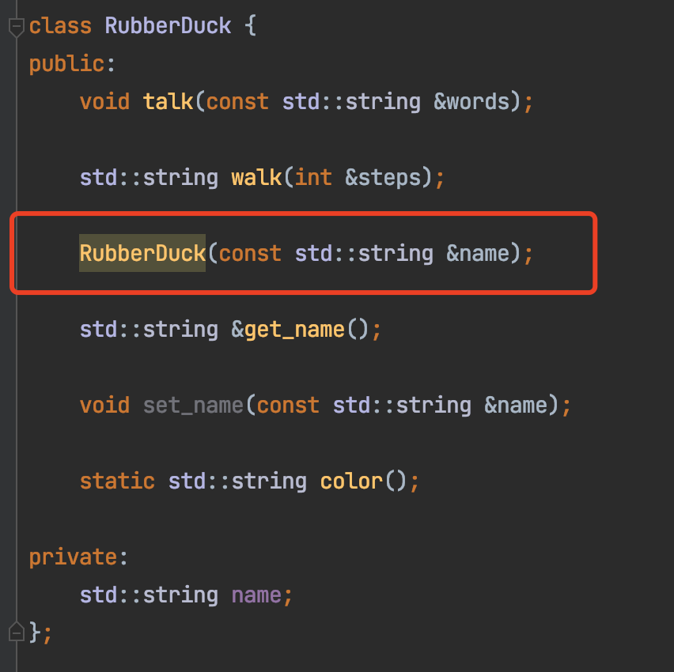
Constructor
Code here

Slide 51
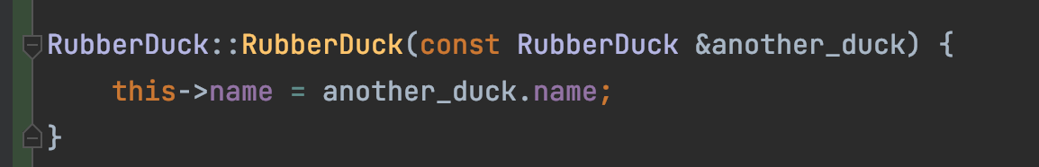
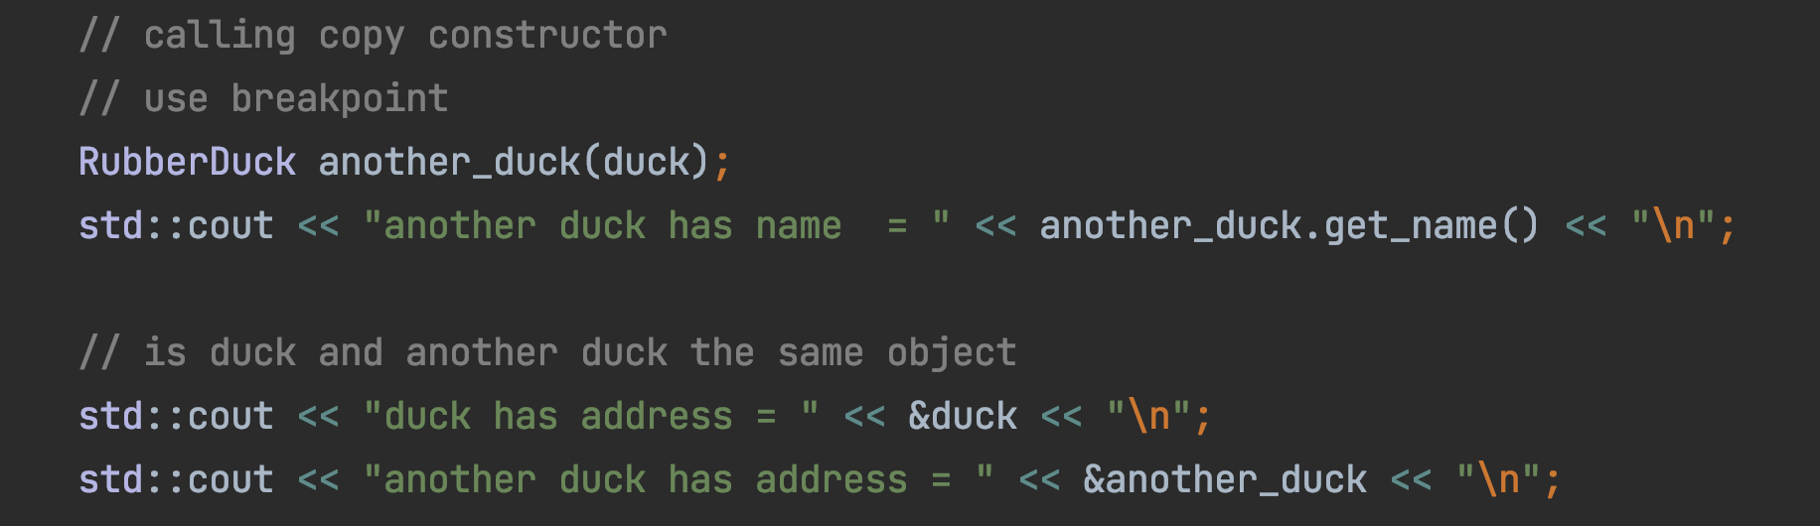
Copy Constructor
copy

Slide 52
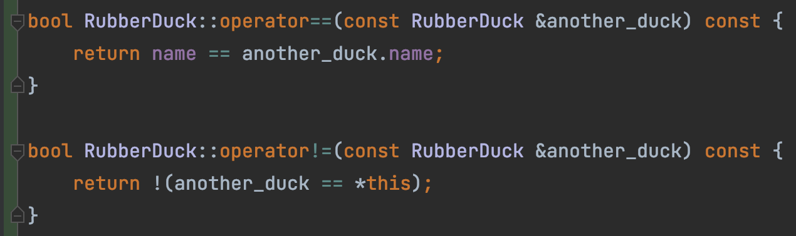
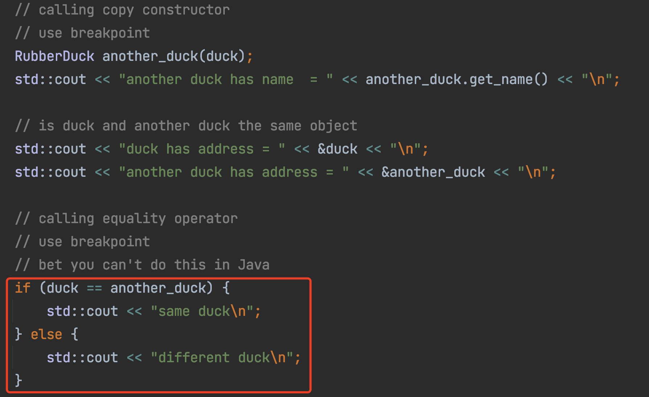
Operator Overload (==, !=)

Slide 53
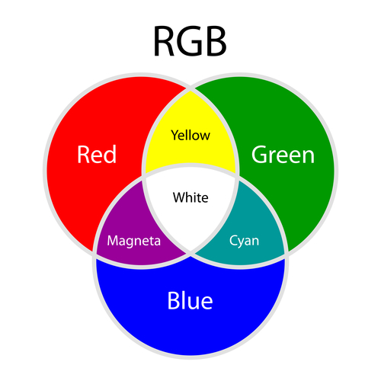
Operator Overload (+)
Red + Green = Yellow
Red + Blue = Magenta
Green + Blue = Cyan

Slide 54
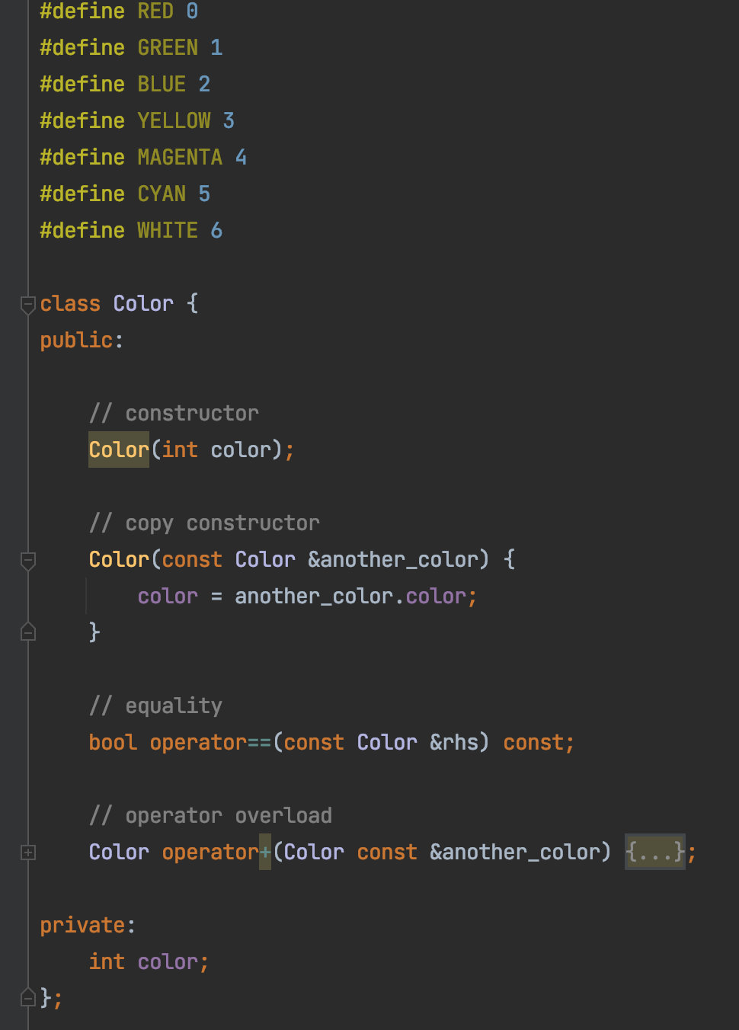
Operator Overload (+)
Code here

Slide 55
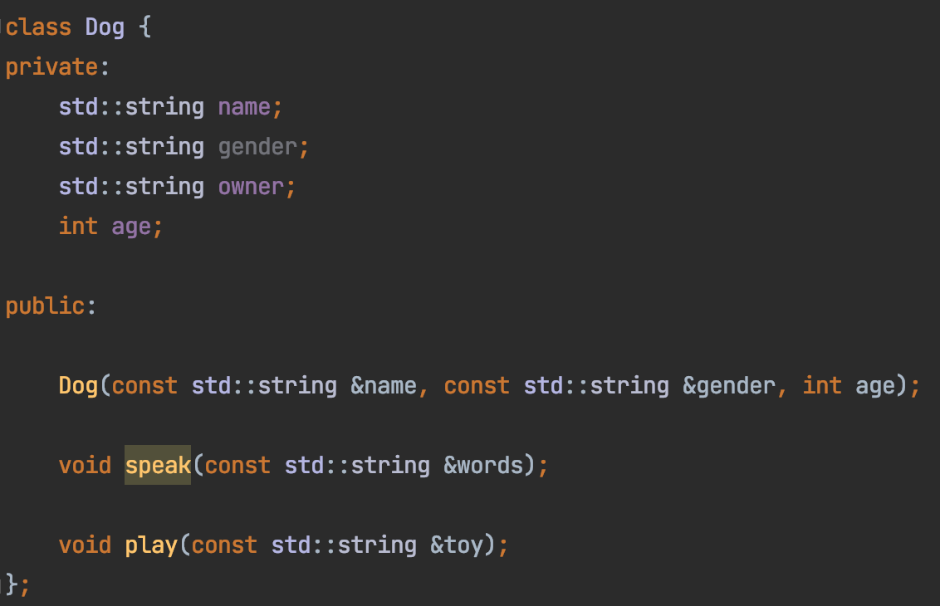
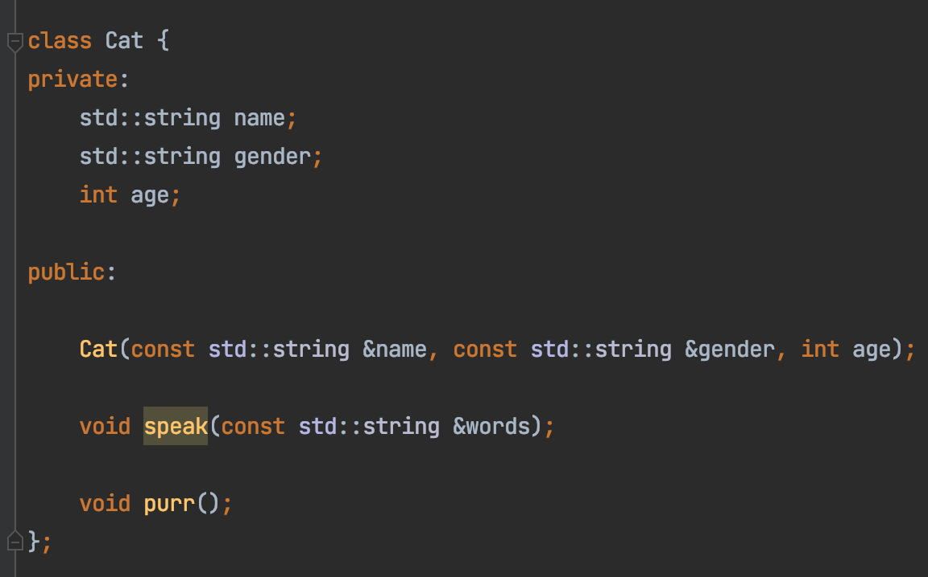
Inheritance
Compare the Cat and Dog class
Mostly Duplicated

Slide 56
Inheritance
Animal Class
Name
Gender
Age
Dog Class
Cat Class
Name
Gender
Age
Name
Gender
Age

Slide 57
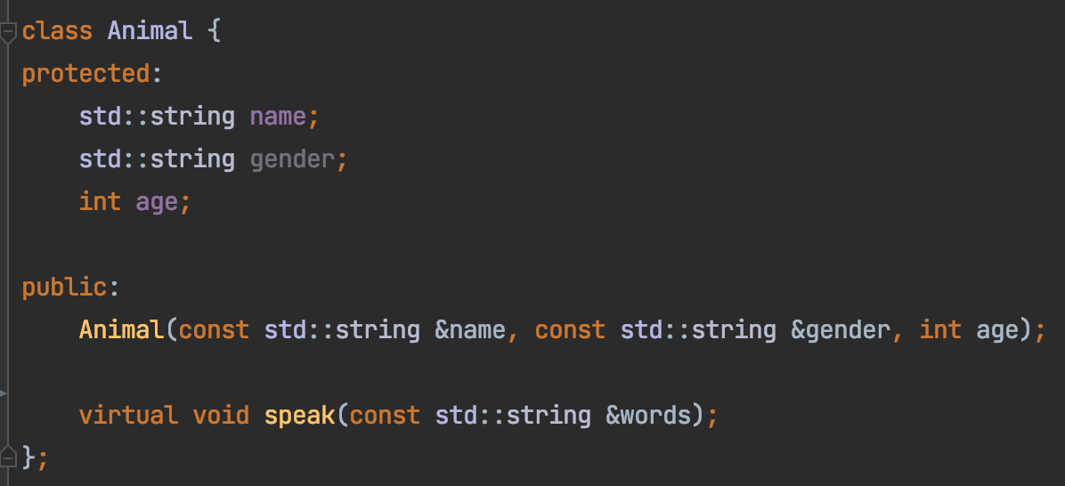
Inheritance
Animal Class
Name
Gender
Age
Base class constructor

Slide 58
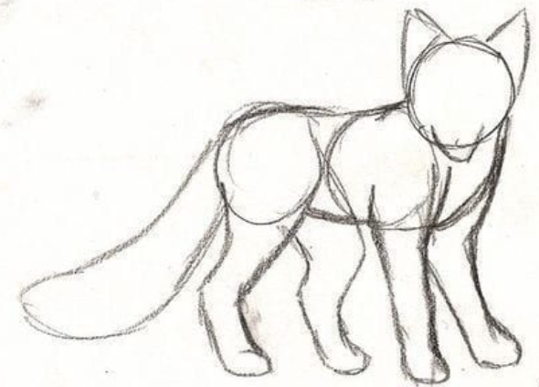
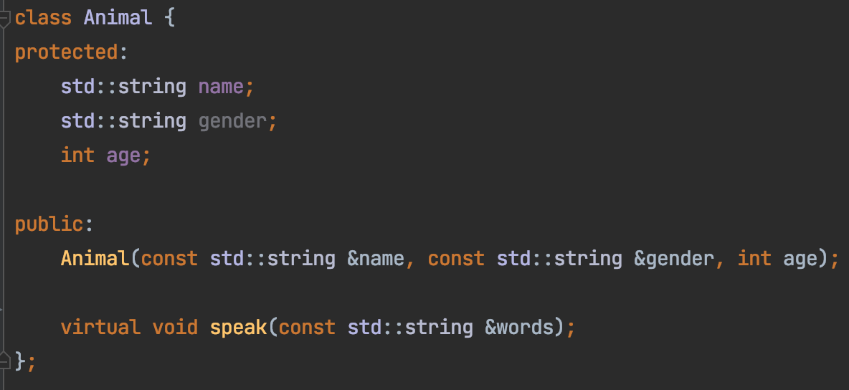


Inheritance

Slide 59
Constructor in A Derived Class
Calling base class constructor

Slide 60


Let all animals play
What if there’s 2000 different animals?

Slide 61

Let all animals play

Slide 62



Let all animals play

Slide 63


Let all animals play
Code here

Slide 64
Animal::speak() is NOT virtual
Derived Class
Cat cat;
Animal * p_cat = &cat;
Animal::speak()
Animal Class
p_cat -> speak()
Cat::speak()

Slide 65
Animal::speak() is virtual
Derived Class
Cat cat;
Animal * p_cat = &cat;
Animal::speak()
Animal Class
p_cat -> speak()
Cat::speak()

Slide 66
Virtual Function Demo
Code here
Base Class
Derived Class
int *base_class_data
Base Class
int capacity
int capacity
get_capacity()
get_capacity()
~BaseClass()
~BaseClass()
Inheritance
int *derived_class_data
get_capacity()
~DerivedClass()

Slide 67




Virtual Function Demo
Base Class
Derived Class

Slide 68


Virtual Function Demo
Derived destructor NOT called → Memory leak!

Slide 69




Virtual Function Demo
Derived class destructor called → Memory leak!

Slide 70
Agenda
Prelude: Tooling
Source code management
Build
Debug
ACT I: Basics
Variable
Pointer, reference
Array
Control flow (loop, if)
Function
ACT II: Memory Management
Heap vs stack memory
new & delete
Memory leak
Bad reference
ACT III: Object Oriented Programming
class
Object/instance
Inheritance
Metamorphism

Slide 71
Code
https://github.com/a-teaching-goose/2022-bootup
https://github.com/a-teaching-goose/2022-bootup#readme
Usage instruction
Two branches, one for IDE and one for command line

